Slide 1
Predicting Likes Quantity For Data Sets In Kaggle

Slide 2
Kaggle is a data science and machine learning online community. Users can use Kaggle to acquire and publish data sets, explore and build models in a web-based

Slide 3
what is the purpose

Slide 4
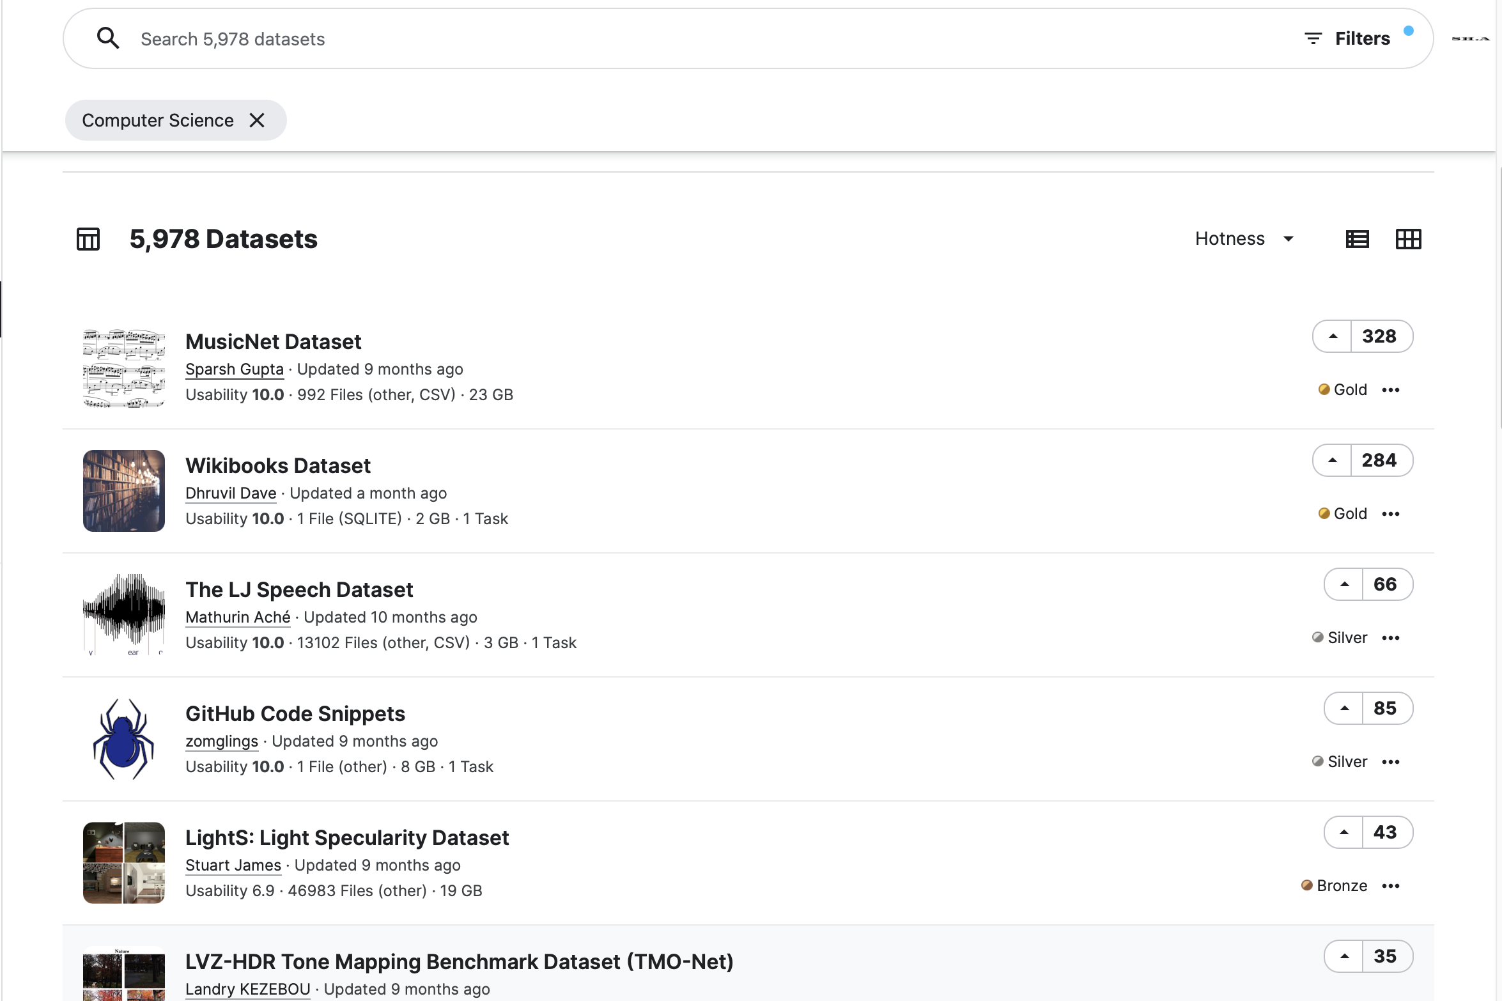

Slide 5
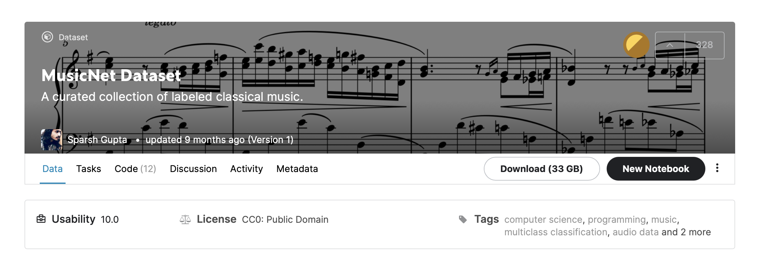
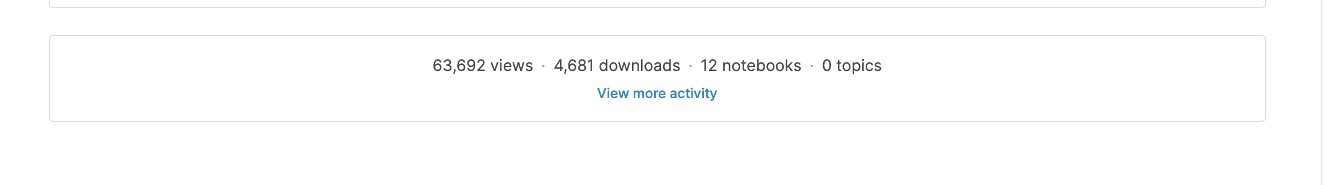

Slide 6
The Collected features
Dataset Name: The name of the dataset
Created By: the person how published the dataset
Rank: There are three levels of award, Bronze, Silver and Gold
Like: number of like in the dataset
Download Size: download size of the dataset
Notebook: number of Jupyter notebooks of the dataset
View:The number of people who had viewed the data

Slide 7


Slide 8
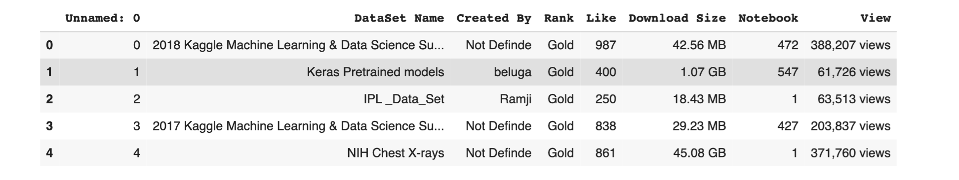
Drop
Fill-in With Mode
Replace With Rate
Remove ‘Views’

Slide 9
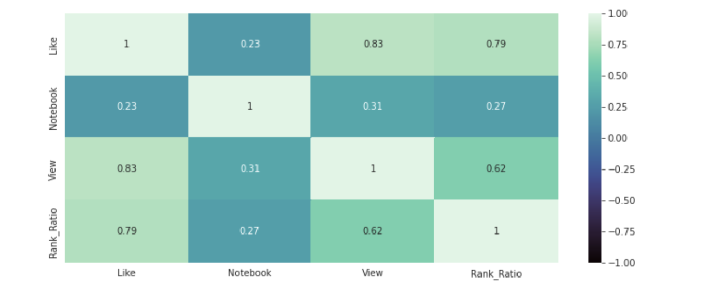
Correlation:

Slide 10
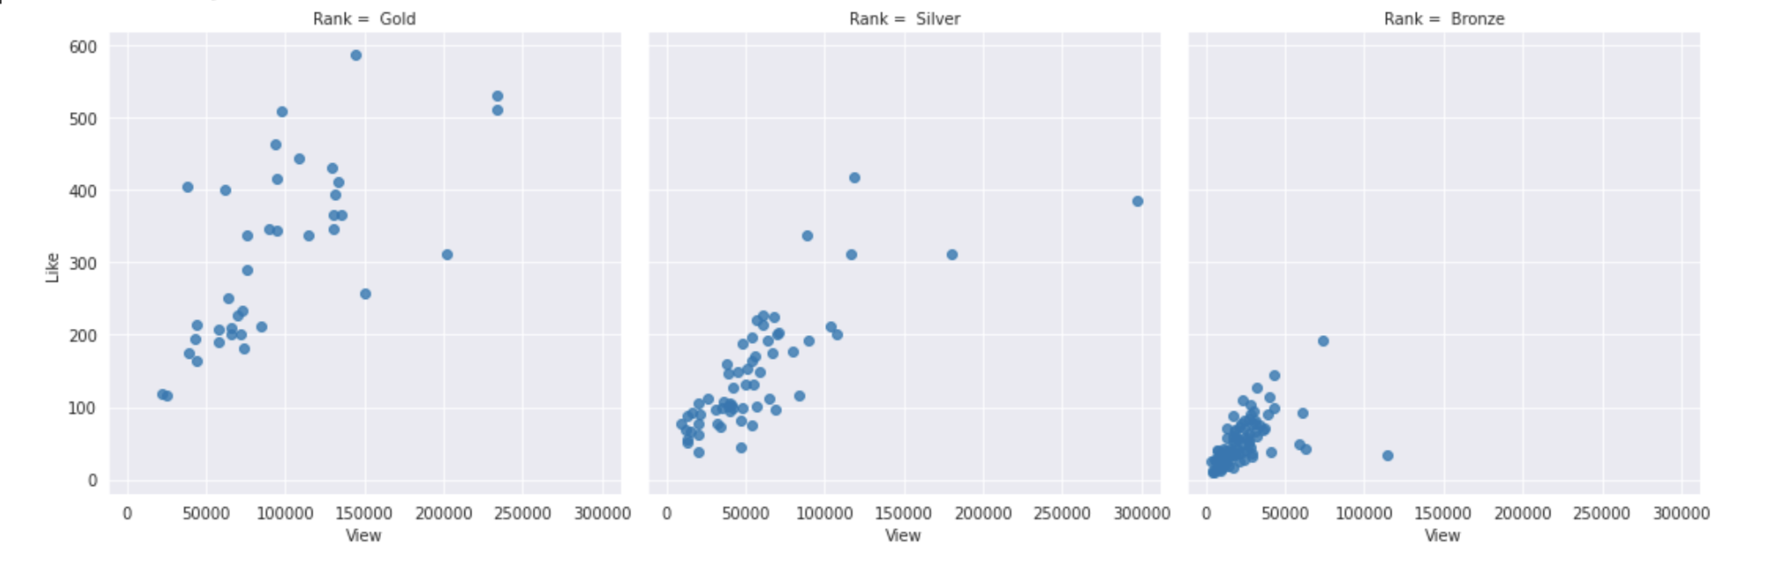
Correlation between the variables:

Slide 11
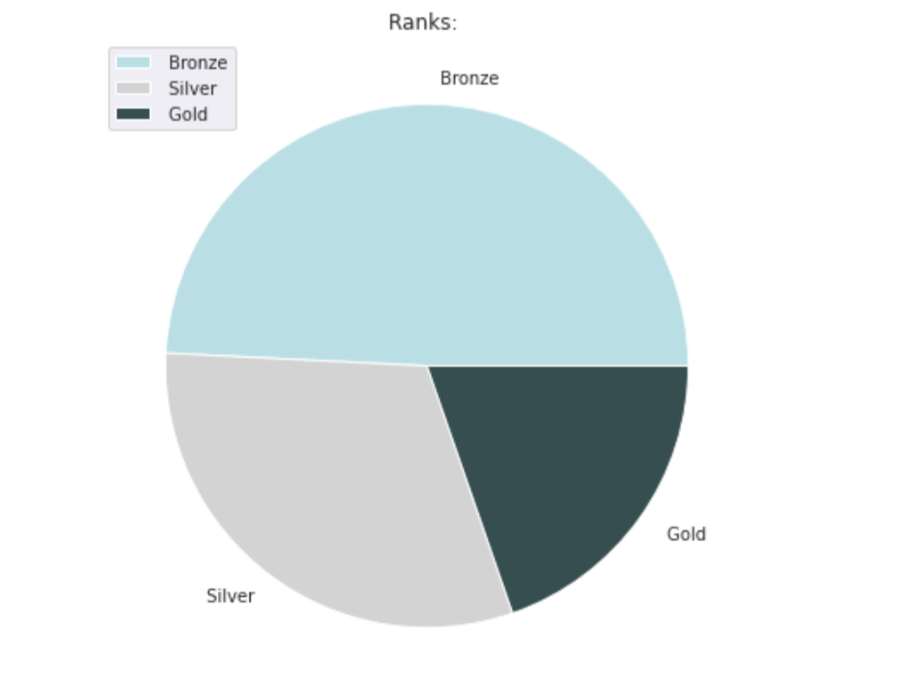
Type of Ranks:

Slide 12
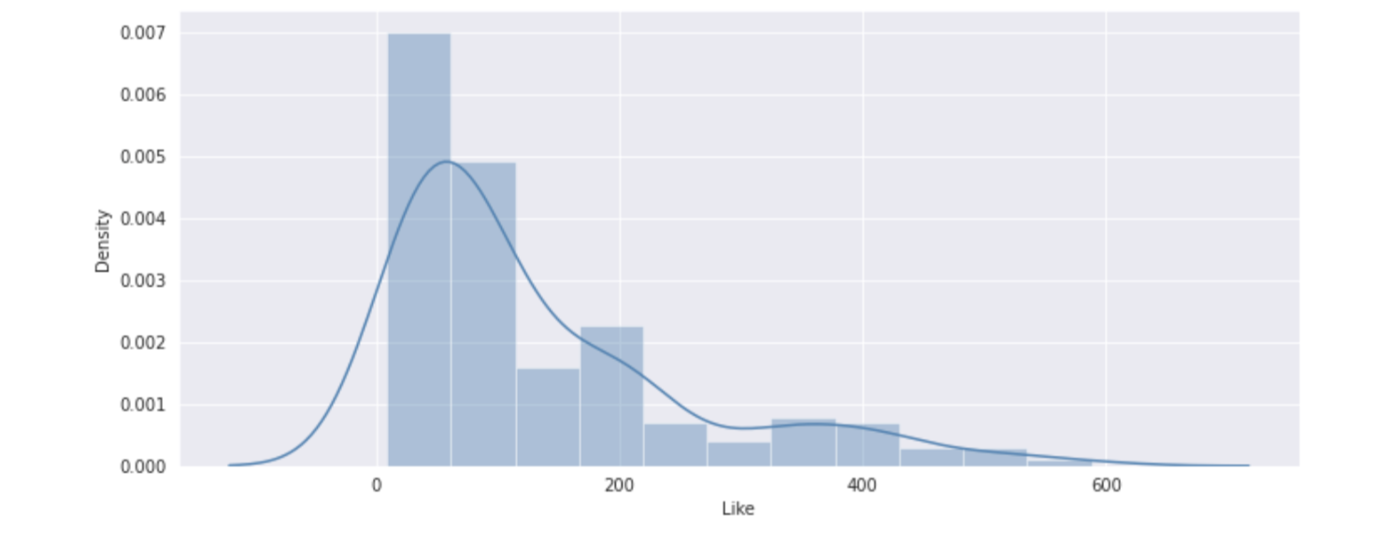
Likes distribution:

Slide 13
Dependent
Independent
Like
Notebook
View
Rank Ratio

Slide 14
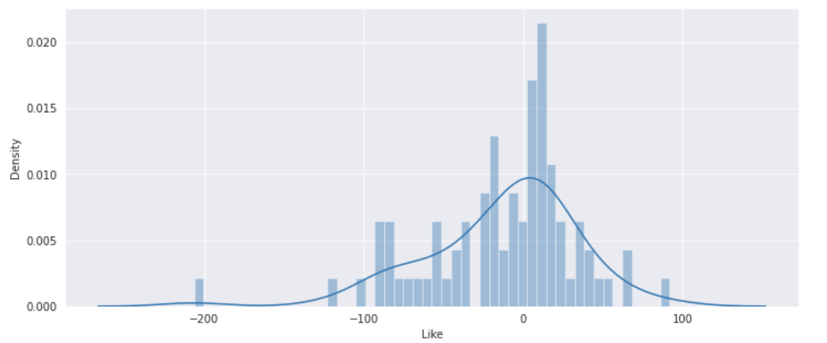
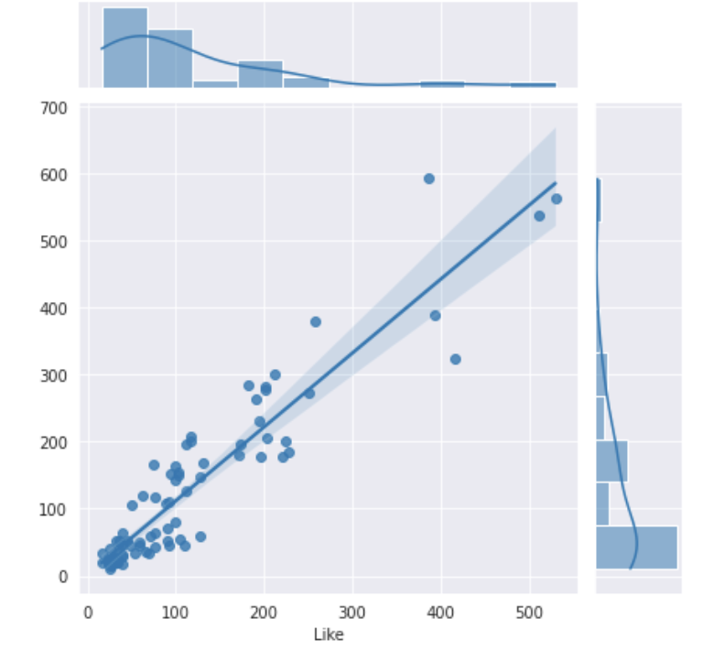
Linear Regression Model:

Slide 15
- Score -
- MSE -
Linear Regression Model:
0.80
2439.50

Slide 16
thanks!
Do you have any questions?

